Slide 1
Group 5 Final Project
---Insights of World Happiness
Team member:
Rui Song
Xiao Wan
Xiaoyu Zhang
May 3^{nd,} 2017

Slide 2
Project Introduction
Background
The World Happiness Report is a landmark survey of the state of global happiness. They ranks 156 countries by their happiness levels and happiness scores.
The factors of describing the state of well-being of countries range from economics, psychology, national statistics, health, public policy, etc.
Inspiration
Capture the underlying pattern of what defines a happiness country, should there be different categories of happiness?
Understand how the each of the six factors contributing to happiness in different patterns of country

Slide 3
Data Source
World Happiness Report (2016)
The World Happiness Report is a landmark survey of the state of global happiness, since 2012, the Sustainable Development Solutions Network (SDSN) publishes it each year.
Wikipedia
Wikipedia is also another import data resource where we gained geological information (latitude and longitude) as well as population and GDP per person

Slide 4
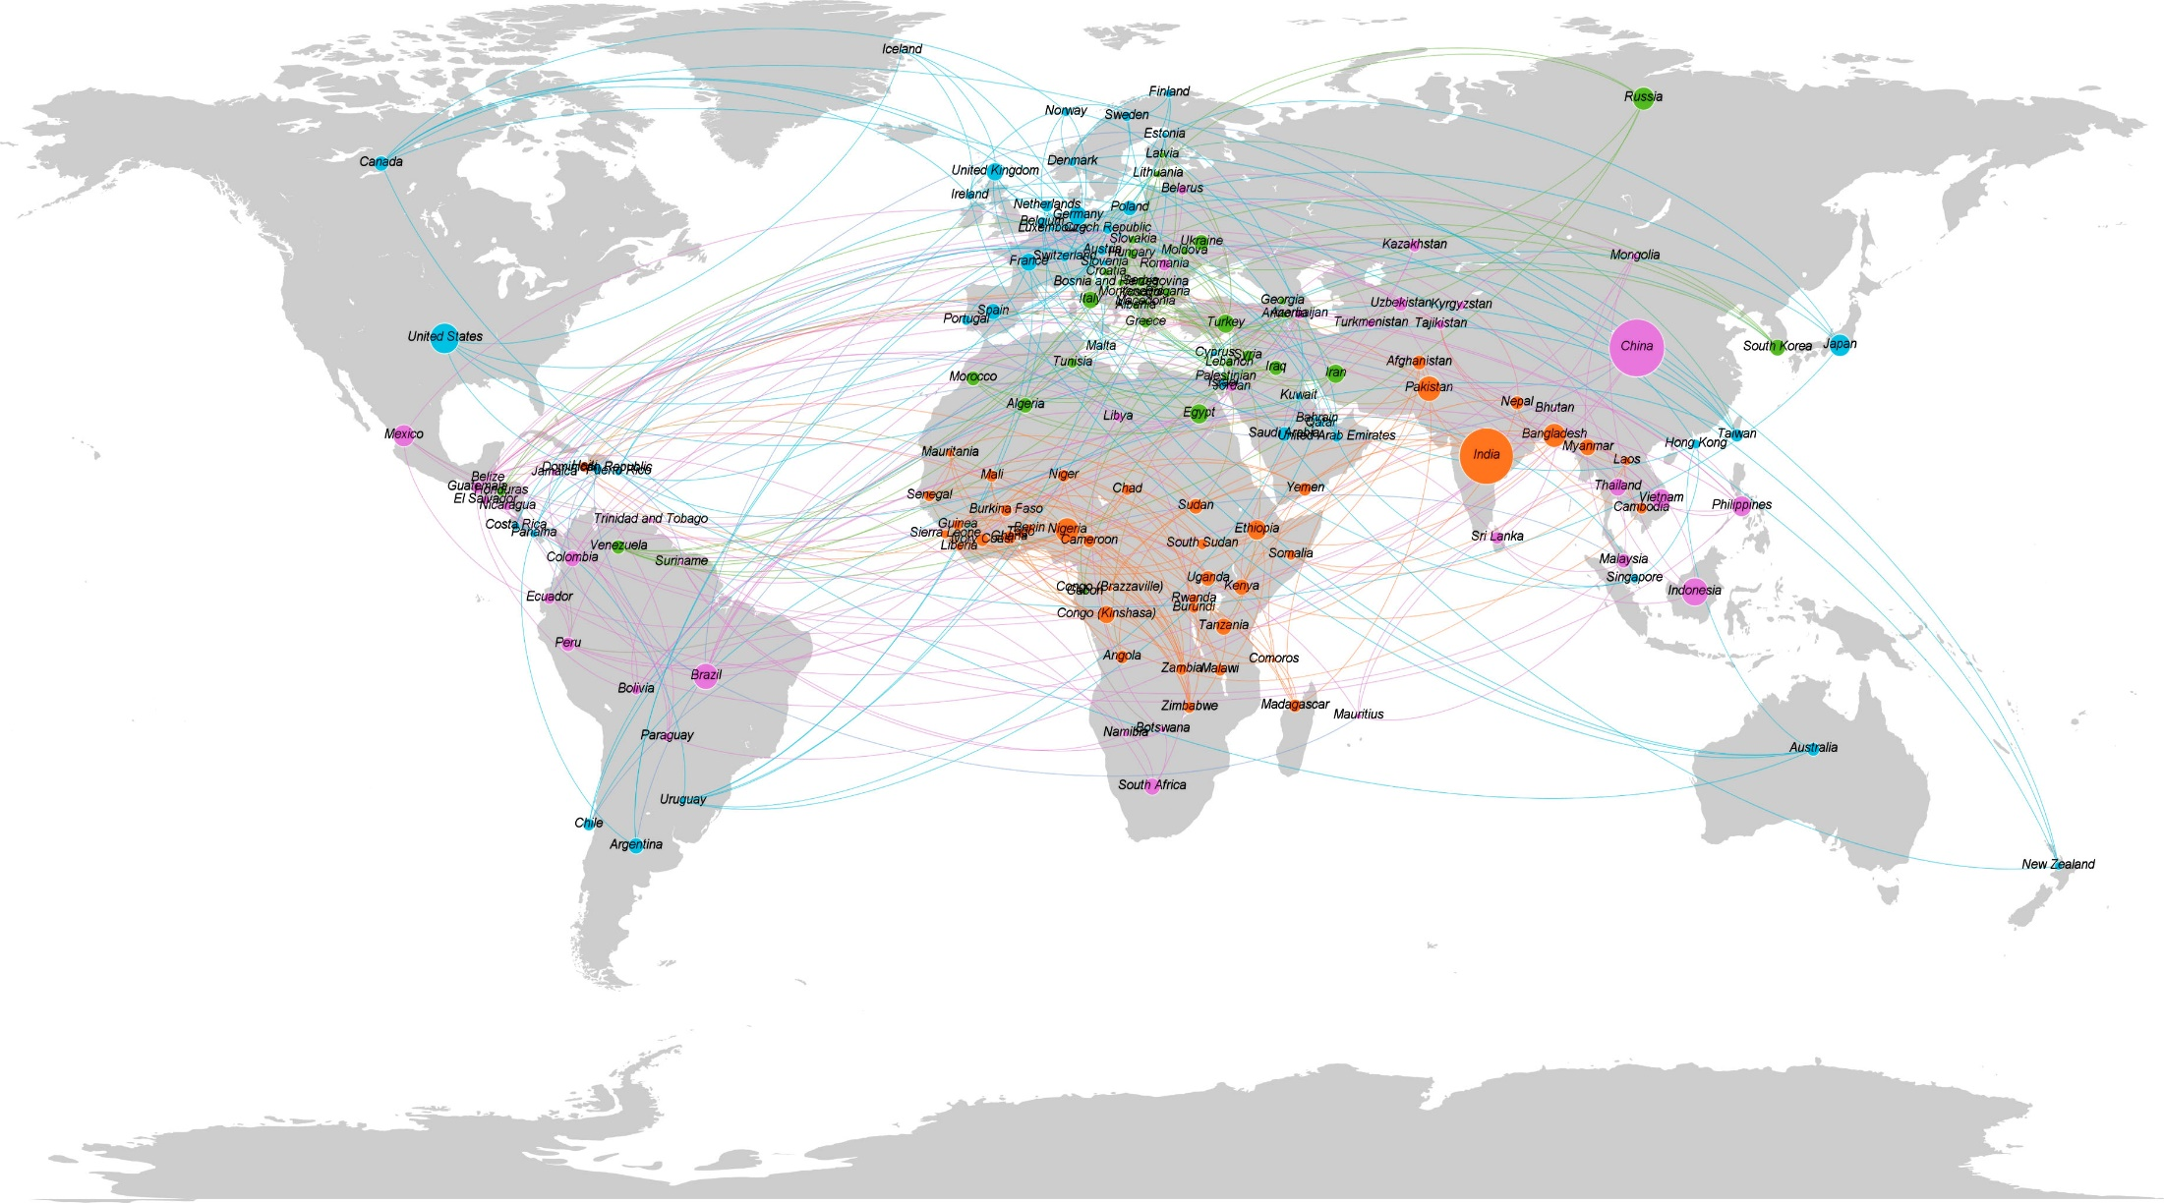
Network Analysis
--- Glimpse of World Map

Slide 5
Network Analysis
--- Approaches to construct
Raw Data
Adjacent Matrix
The survey considers six attributes as indicator of happiness: Economy, Family, Health, Freedom, Trust, Generosity.
For each attribute, calculate the absolute distance between two countries, and normalize between the scale of 1:10
Filter Edges
Integrate Matrix
Last to reduce the amount of edges (156 * 155), we choose to only detect the strongest five connections. (less than 156*5)
Add up the pair-wise comparison between countries in regard to the six attributes. To get the overall connection between two countries.

Slide 6
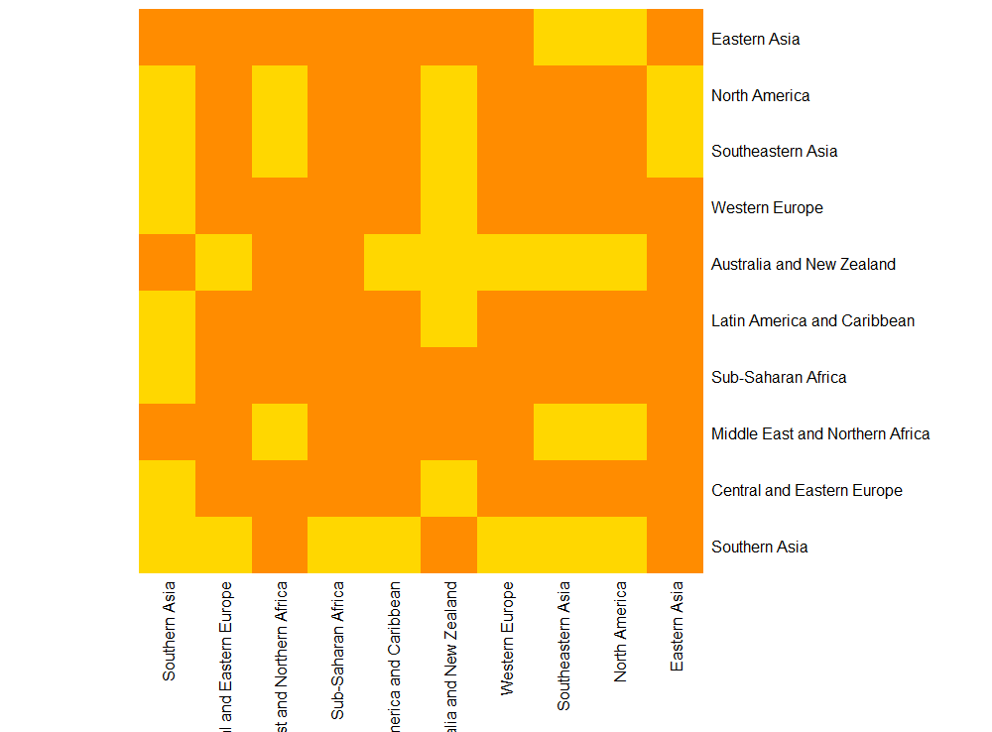
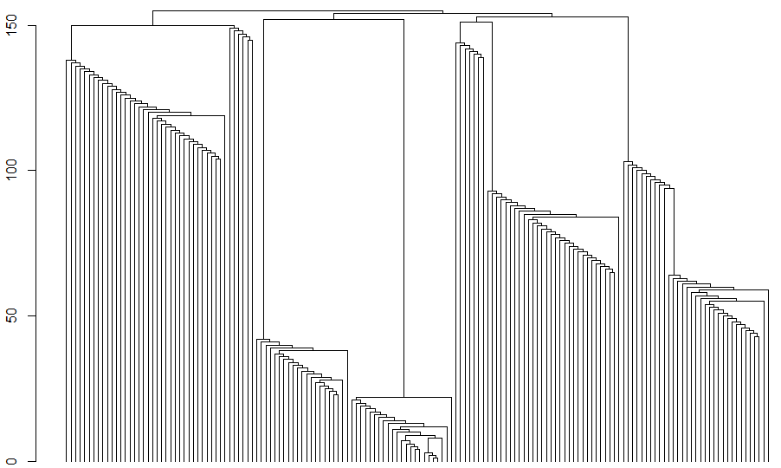
Community Analysis
Heatmap is one method to research on how to cluster countries, but instead of pair-wise comparison, we decided to use regions to understand pattern.
Hierarchical clustering is another method to understand the connection between countries. The result shows a clear four cluster pattern.
Countries were categorized as developing countries and developed countries. But developing countries varies extremely differently. Nigeria and China are both developing countries, but at least for most people, China is regard as a better country to live.

Slide 7
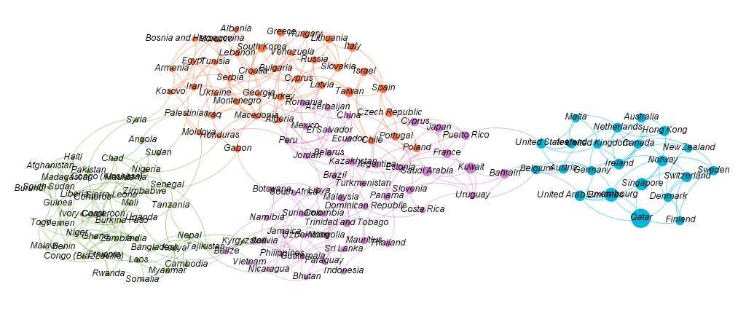
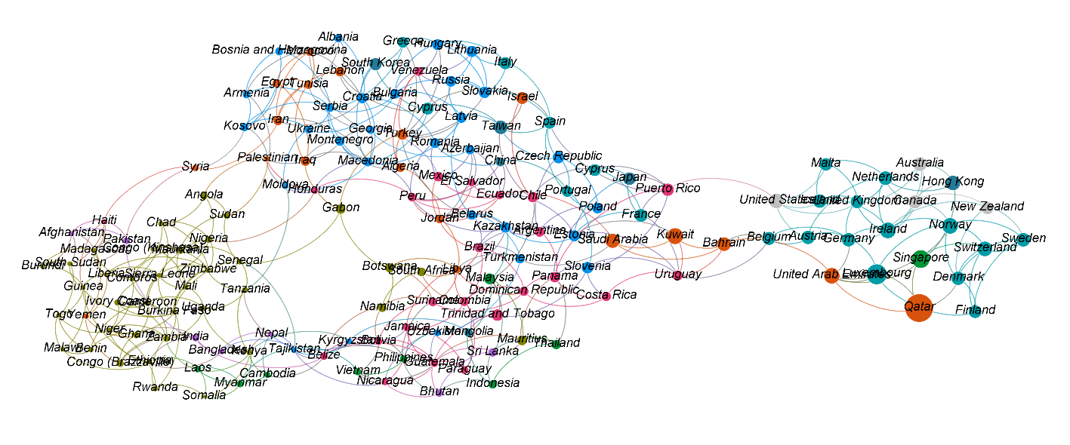
Community analysis
Happiness
From left to right, The happiness score increases, the size of each node is proportional to GDP per capital, Which strongly indicates that happiness is strongly affected by income.
Happiness Score
Region Distribution
Compare to the upper picture, We can see that the most unhappy countries centralized in Sub-Saharan Arica. While the happiest countries mostly locates in Western Europe. Mean while, in the middle part, one part is dominated by Central and Eastern Europe countries

Slide 8
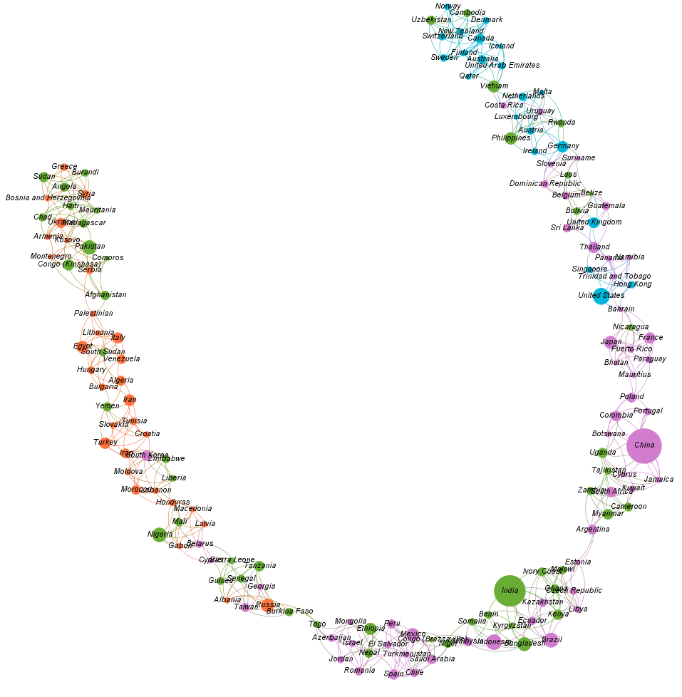
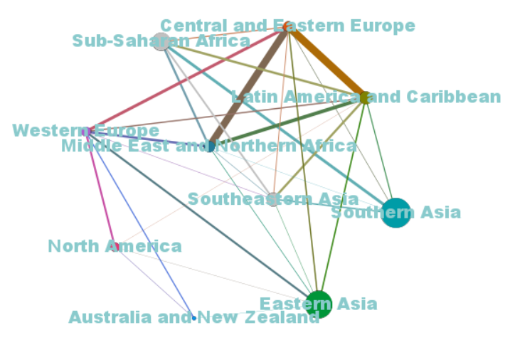
Community analysis
--- Region & Freedom
Regional Connections
Central and Eastern Europe, Latin America and Caribbean, Middle East and Northern Africa are quite alike. Which fits our intuition.
Western Europe shows connection to every region except Sub-Saharan Africa and Southern Asia while the two regions show high similarity.
Southern Asia is quite distinct from Eastern Asia
Happiness & Freedom
In terms of freedom, We again see a high correlation between high happiness and high freedom. For the countries which have similar economy, the different level of freedom attribute to the difference of happiness score.
Notes:
Next step, We consolidated the big graph by region, to get a clear view of similarity between regions.

Slide 9
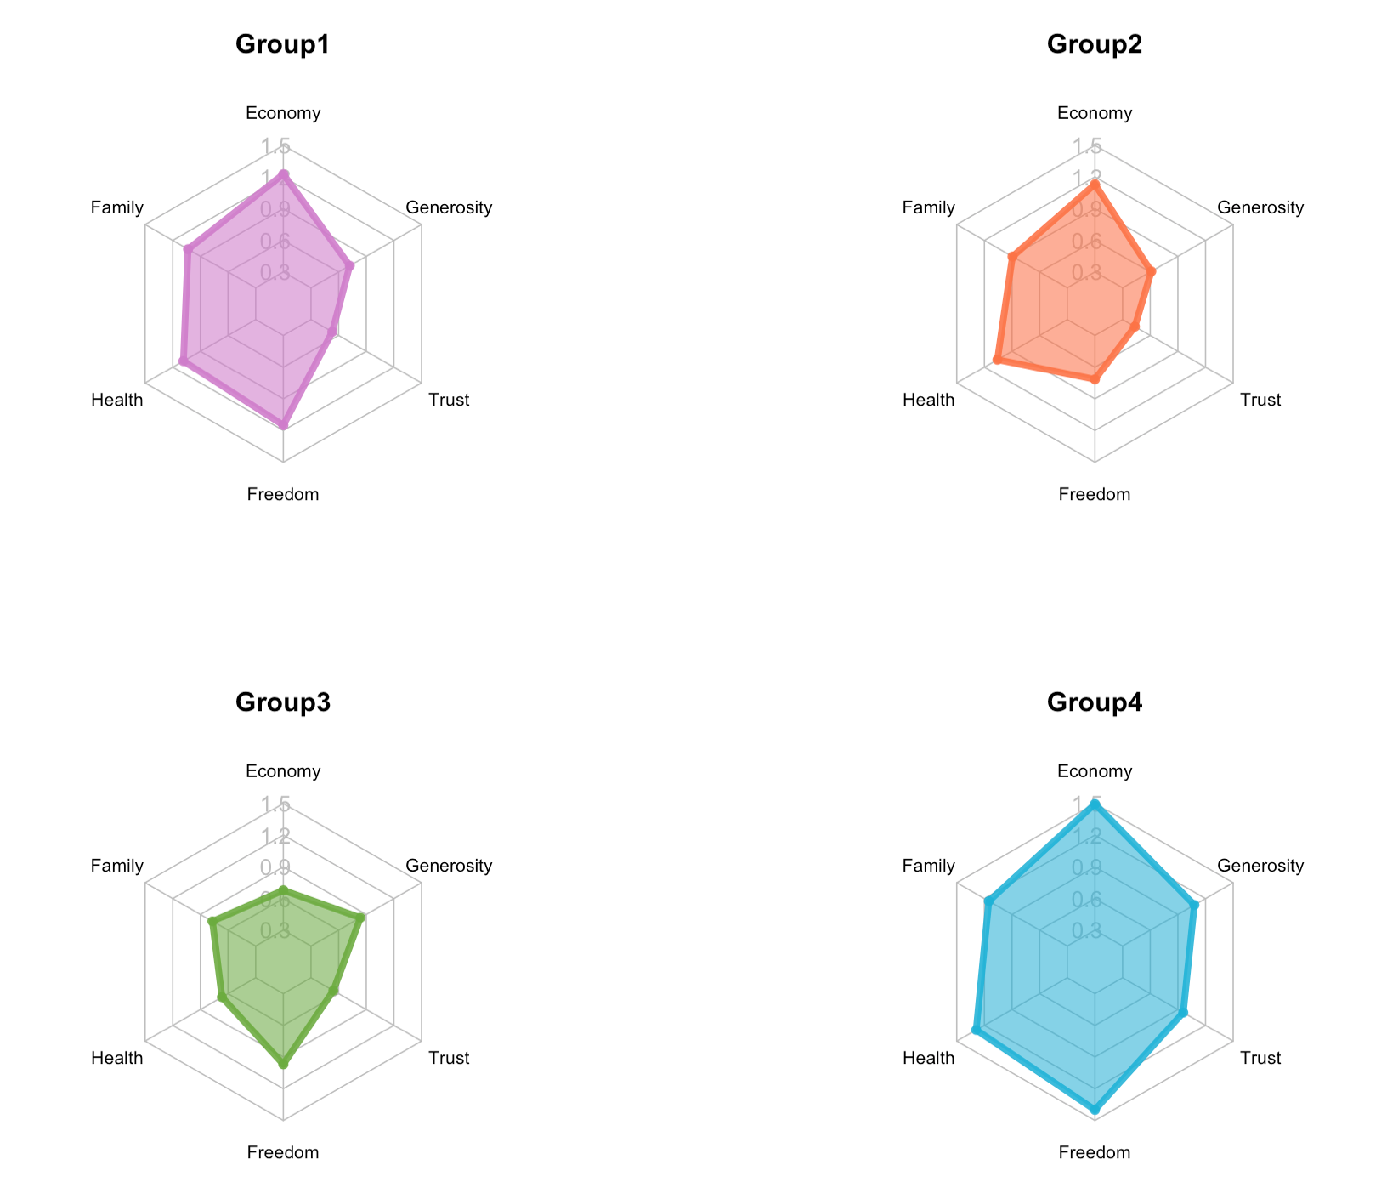
Community analysis --- Patterns
Four Groups:
Difference:
Big difference in economy level (GPD per capital)
Big difference in freedom score
Common:
Close health score (Life expectancy)
High average family score
Various generosity
Low average trust in government
Representative region
Notes:
Generosity: social support.

Slide 10
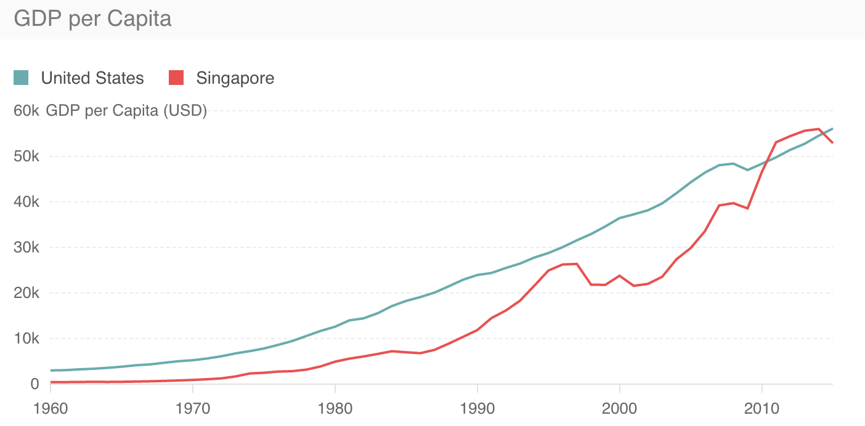
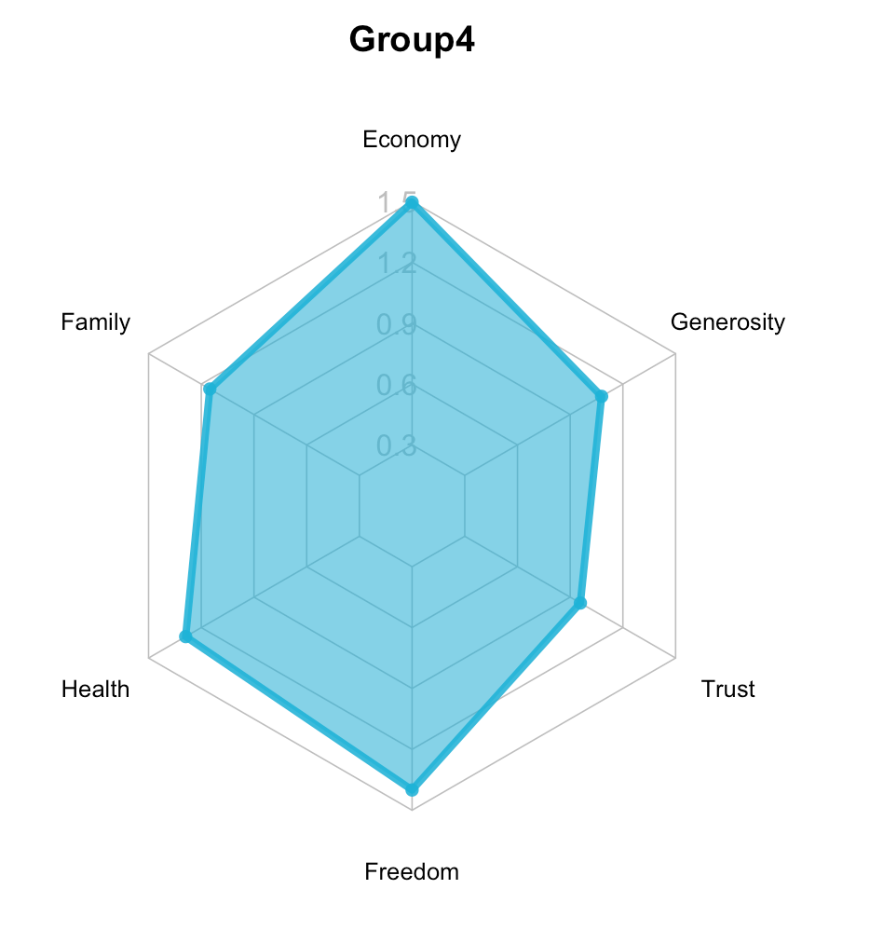
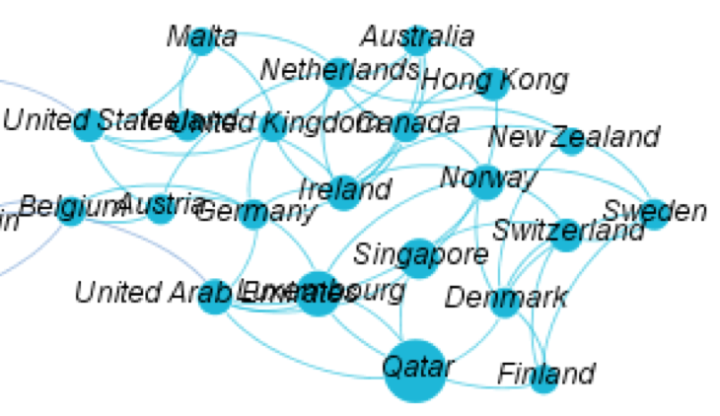
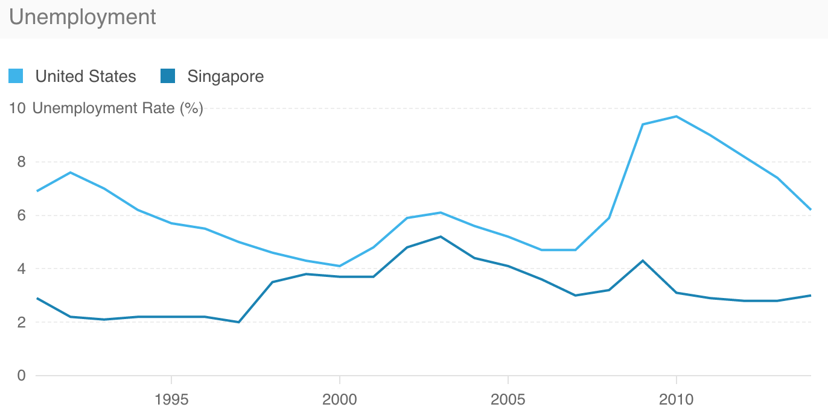
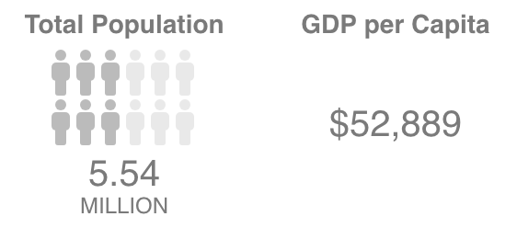
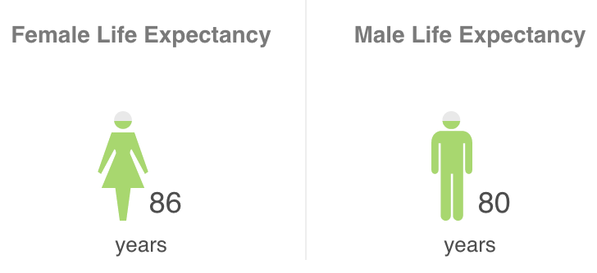
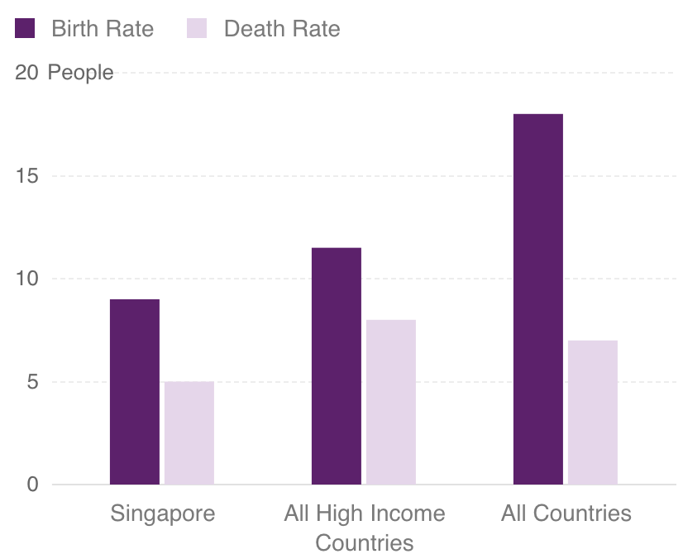
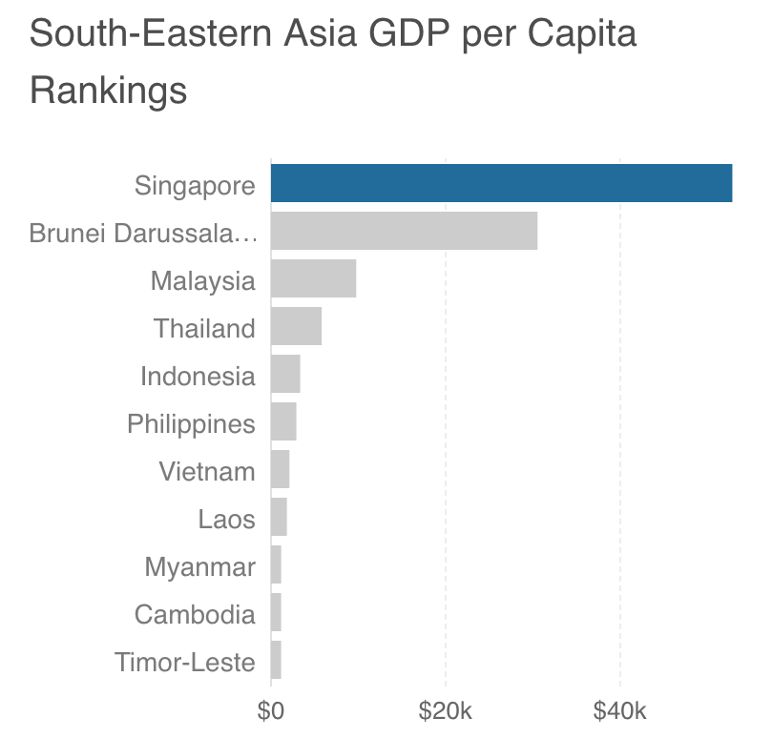
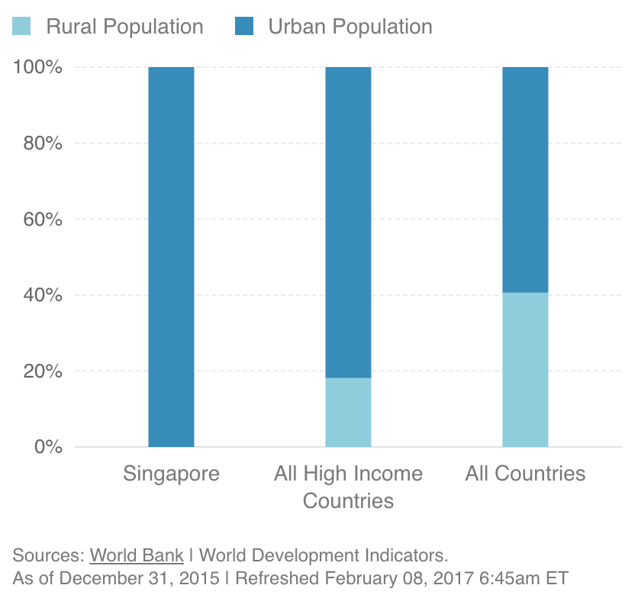
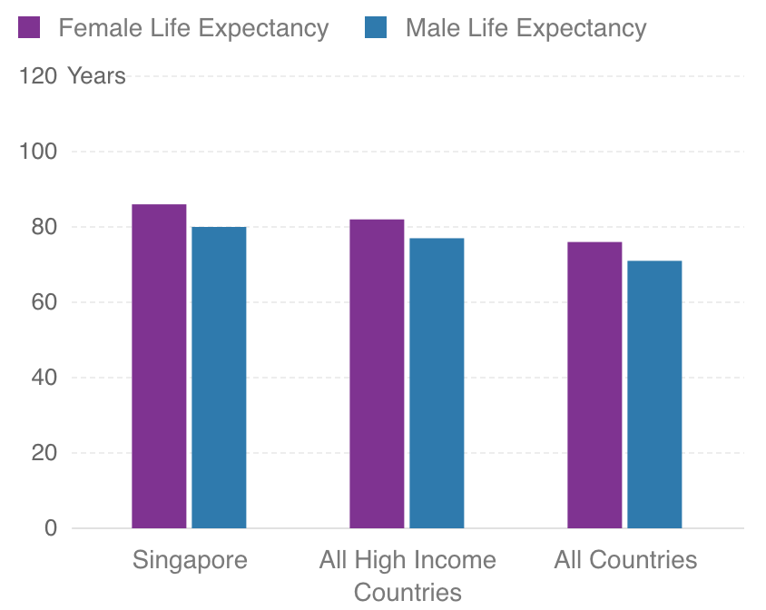
Community analysis --- Group 4
Group 4
Characteristic:
Highest GDP
Longest life expectancy
High freedom
High generosity
Good trust in government
Representative:
United States
Sweden
New Zealand
Singapore
Region:
Southeastern Asia
Similar:
U.S., Norway, H.K.
Characteristic:
Republic
Almost Completely Urban
Low unemployment rate
Very Low Birth Rate and Death Rate

Slide 11
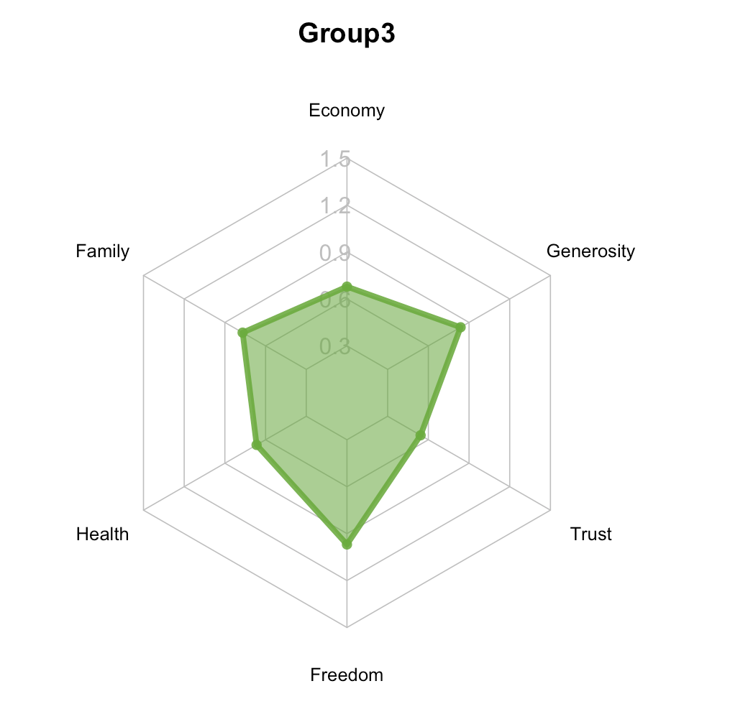
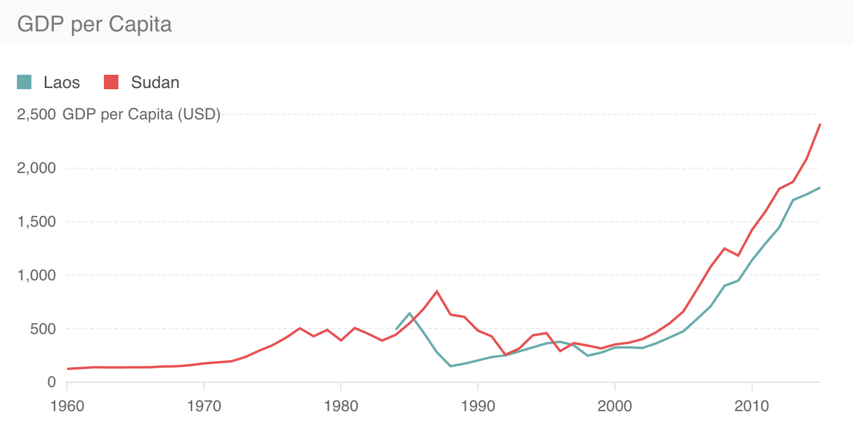
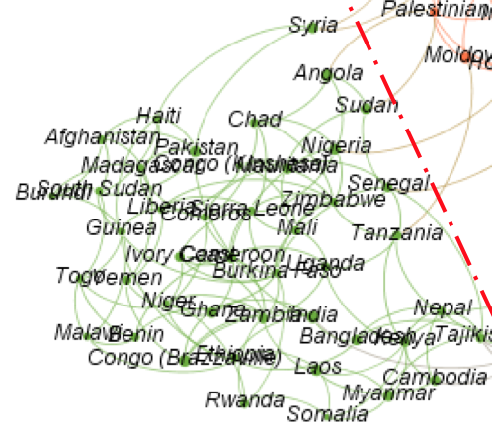
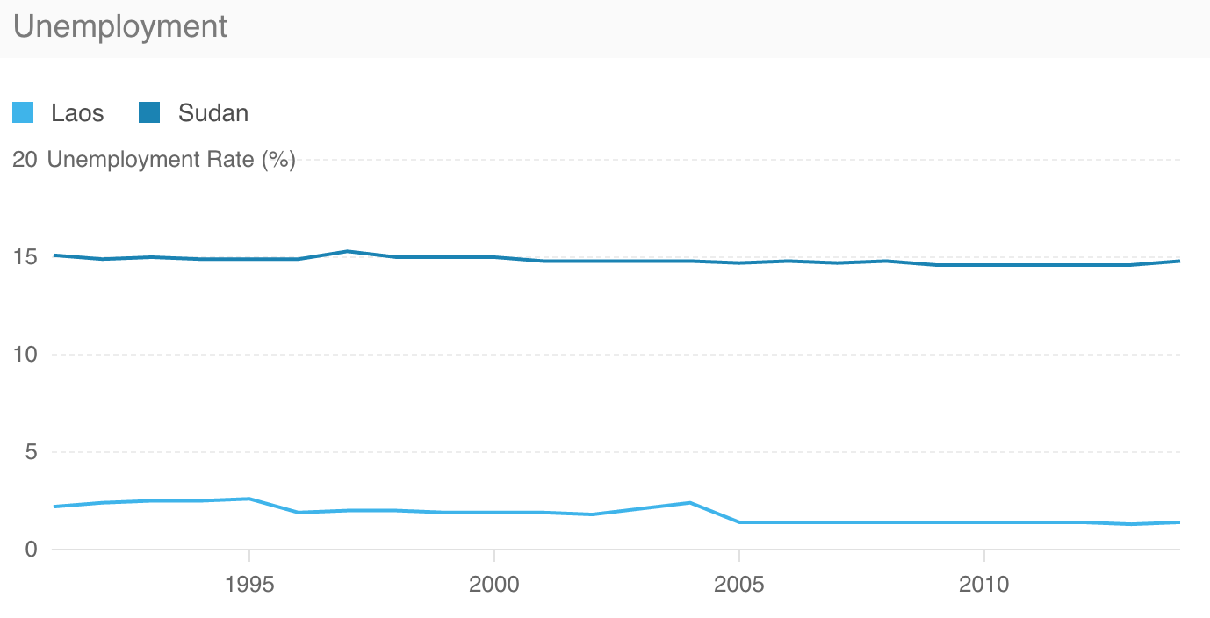
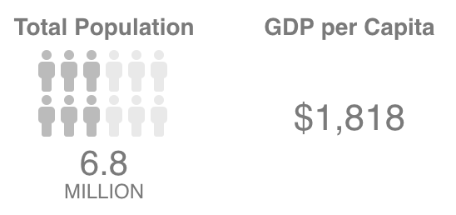
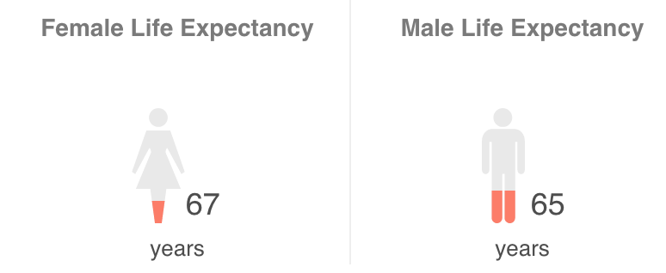
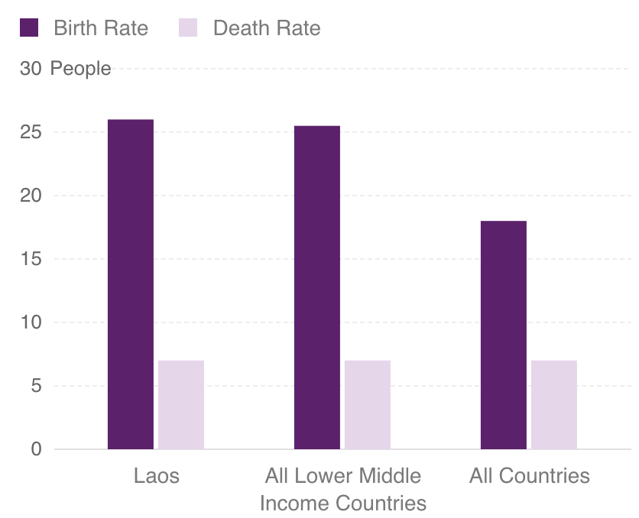
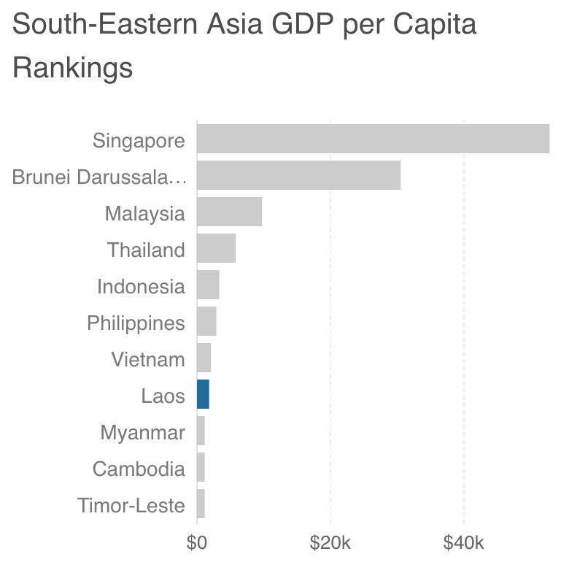
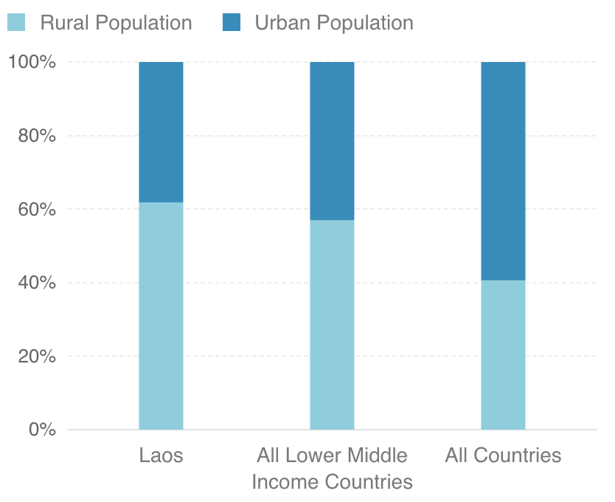
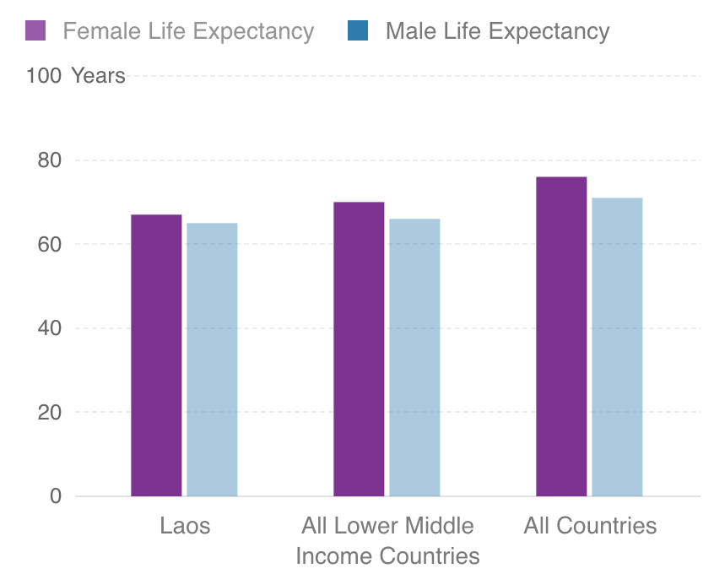

Community analysis --- Group 3
Group 3
Characteristic:
Low average GDP
Short life expectancy
High freedom
High generosity
Representative:
Nepal
Laos
Sudan
Laos
Region:
Southeastern Asia
Similar:
Somalia, Myanmar
Characteristic:
Communist
Low GDP per Capita, Growing Rapidly
Extremely Low Unemployment Rate
Short Life Expectancy
Notes:
This comparison is kind of cruel, but is also representative of the unbalance situation between countries all over the world. And also a reminder for us to try our best to eliminate this phenomenon for people who are struggling to live a peaceful and meaningful life.

Slide 12
Conclusion
Overall
Through our community analysis we get four clusters. The four clusters have obviously regional attribute.
For six factors, Economy (GDP per Capita) has the most significant effect on happiness, then Freedom and Health.
Group
The distribution of each group on six factors was significantly different.
In each group, there are some exception when taking geographical factors into account.
Limitation

Slide 13
Rui Song, Xiao Wan, Xiaoyu Zhang
Couse BIA 658
Instructor Feng Mai

